Slide 1
Activation
Functions
in Deep Learning · ANN · Neural Networks
Why?
Sigmoid
Tanh
ReLU
Leaky ReLU
Softmax

Slide 2
❓ Why Activation Function?
An activation function introduces non-linearity into the model, enabling it to learn complex patterns beyond simple linear relationships.
⚠️ Without activation functions — neural network behaves like a simple linear regression model (no matter how many layers).
Output = f(z) where z = Σ(xᵢ × wᵢ) + b
Non-linearity
Expressiveness
Differentiation
Learn complex patterns
Solve real-world problems
Backpropagation works

Slide 3
📋 Types of Activation Functions
1
Sigmoid
▸ Binary classification
2
Tanh
▸ Better gradient than Sigmoid
3
ReLU
▸ Hidden layers — most popular
4
Leaky ReLU
▸ Solves Dying ReLU problem
5
Softmax
▸ Multi-class classification

Slide 4
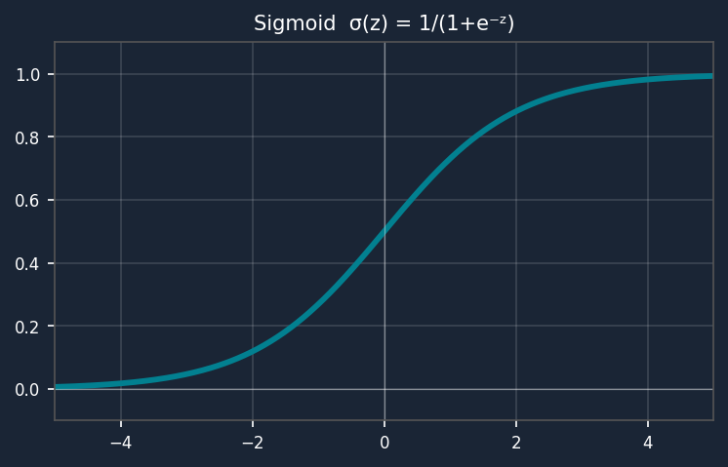
1️⃣ Sigmoid Activation Function
f(z) = σ(z) = 1 / (1 + e⁻ᶻ)
Derivative: f'(z) = f(z) · (1 - f(z))
Output Range:
(0, 1)
Use Case:
Binary classification (output layer)
S-shaped curve
Output always between 0 and 1
Gradient becomes tiny near extremes
→ causes vanishing gradient
Advantage:
Smooth gradient, probabilistic output
Disadvantage:
Gradient Vanishing Problem — slow learning

Slide 5
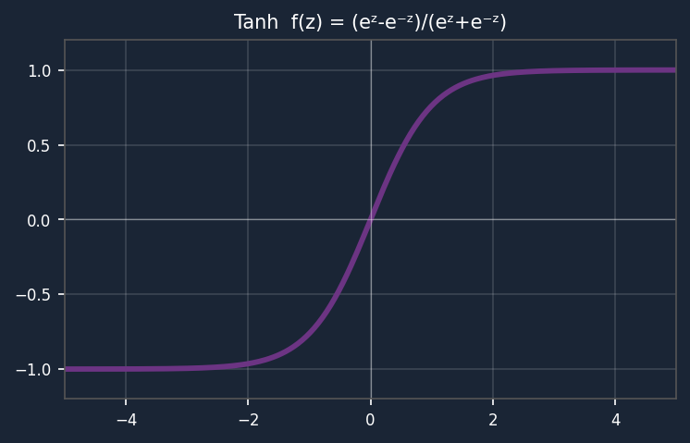
2️⃣ Tanh (Hyperbolic Tangent) Activation
f(z) = (eᶻ - e⁻ᶻ) / (eᶻ + e⁻ᶻ)
Derivative: f'(z) = 1 - (f(z))²
Output Range:
(-1, 1)
Use Case:
Hidden layers, sequence models
S-shaped, centered at zero
Similar to Sigmoid but range (-1,1)
Zero-centered → helps optimizer
Still vanishing gradient at extremes
Advantage:
Zero-centered — better gradient flow
Disadvantage:
Still has vanishing gradient for deep nets

Slide 6
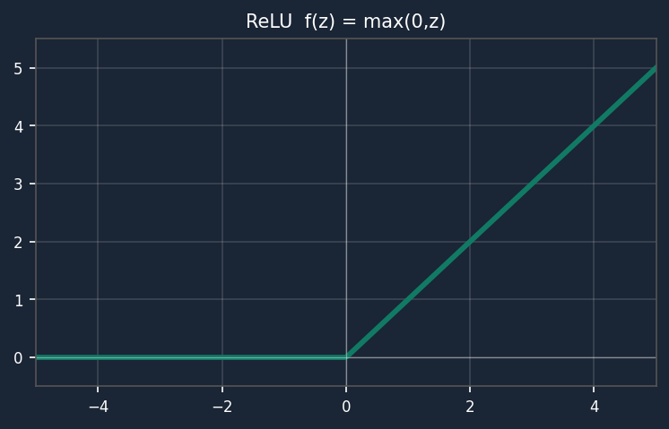
3️⃣ ReLU — Rectified Linear Unit
f(z) = max(0, z)
f'(z) = 1 if z > 0, 0 if z ≤ 0
Output Range:
[0, ∞)
Use Case:
Hidden layers — most widely used
Flat for z < 0 (outputs 0)
Linear for z > 0
Most popular for hidden layers
Dying ReLU: neurons get stuck at 0
Advantage:
Fast computation, no vanishing gradient (positive side)
Disadvantage:
Dying ReLU — neurons output 0 for all negative inputs

Slide 7
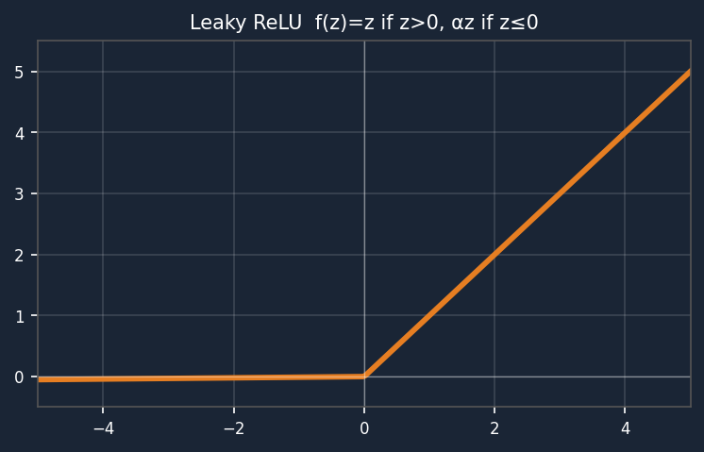
4️⃣ Leaky ReLU (Parametric ReLU)
f(z) = z if z > 0
f(z) = α·z if z ≤ 0
f'(z) = 1 if z > 0, α if z ≤ 0 (α ≈ 0.01)
Output Range:
(-∞, ∞)
α value:
Small constant (0.01 or 0.02)
Small slope for z < 0 (not flat!)
Linear for z > 0
Fixes Dying ReLU problem
α controls the negative slope
Advantage:
Solves Dying ReLU — small gradient for z < 0
Disadvantage:
α is a hyperparameter to tune

Slide 8
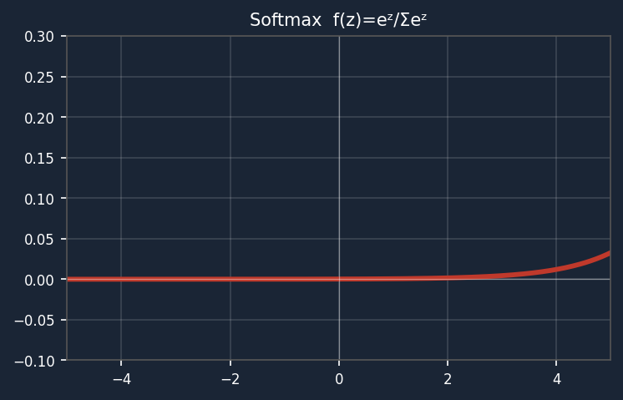
5️⃣ Softmax Activation Function
f(zᵢ) = eᶻⁱ / Σⱼ eᶻʲ
Output Range:
(0, 1) & all outputs sum to 1
Use Case:
Multi-class classification (output layer)
Advantage:
Outputs probabilities — easy to interpret
Converts raw scores to probabilities
All outputs add up to 1.0
Used ONLY in output layer
For: image class, NLP, multi-label
Disadvantage:
Computationally more expensive
Cat: 0.70 | Dog: 0.20 | Bird: 0.10 → total = 1.0

Slide 9
📊 Comparison of Activation Functions
Function
Formula
Range
Best For
Weakness
Sigmoid
1/(1+e⁻ᶻ)
(0, 1)
Binary classification
Vanishing gradient
Tanh
(eᶻ-e⁻ᶻ)/(eᶻ+e⁻ᶻ)
(-1, 1)
Hidden layers
Vanishing gradient
ReLU
max(0, z)
[0, ∞)
Hidden layers (most)
Dying ReLU
Leaky ReLU
z or α·z
(-∞, ∞)
Fixing Dying ReLU
Tune α value
Softmax
eᶻⁱ/Σeᶻʲ
(0,1), Σ=1
Multi-class output
Expensive compute

Slide 10
Quick Summary
Why Needed
Adds non-linearity — lets network learn complex patterns
Sigmoid
Range (0,1) — use for binary output — vanishing gradient problem
Tanh
Range (-1,1) — zero-centered — better than sigmoid
ReLU
f=max(0,z) — fastest, most popular — dying ReLU problem
Leaky ReLU
f=αz for z≤0 — fixes dying ReLU — α≈0.01
Softmax
Outputs sum to 1 — probabilities — multi-class output layer
Key Rule
Hidden layers → ReLU | Binary output → Sigmoid | Multi-class → Softmax

